Slide 1
Film Analytics
D A T A D A W G S
Siddhant Sutar, Dalton Childers, Neil Matin, Abhimanyu Tomar

Slide 2
PROGRESS
Dataset: Movie data for ~1.1 million movies obtained from OMDb, stored in a csv file (size: ~500mb)
Machine learning model: Multiple linear regression

Slide 3
VARIABLES
Independent variables (features):
Rating (PG-13, R, etc.)
Genre(s)
Director(s)
Writer(s)
Actors
Dependent variable (outcome):
IMDb rating

Slide 4
MODEL
Using Pandas, create feature vectors for the independent variables: rating, genre(s), director(s), writer(s), actors. For example, a typical feature vector for actors would be a dataframe that would have movie IDs as rows and list of actors (from the movies in the dataset) as columns. If a specific actor was present in a specific movie, their intersection would have value 1; 0 otherwise.
Concatenate the feature vectors to the original dataframe.

Slide 5

MODEL
Import scikit-learn module, instantiate the linear regression model and “fit” the x and y dataframes corresponding to the user-specified feature columns and the outcome prediction column.
For example, if the user entered “R”, “Quentin Tarantino”, “Leonardo DiCaprio” as the predictors, dataframe x would contain only those columns from the original dataset.
The x corresponds to x-axis which represents the independent variables, and the y corresponds to y-axis which represents the dependent variable in the following multiple linear regression equation:

Slide 6
MODEL
Since all the independent variables are categorical, this is also known as an analysis of variance (ANOVA).

Slide 7
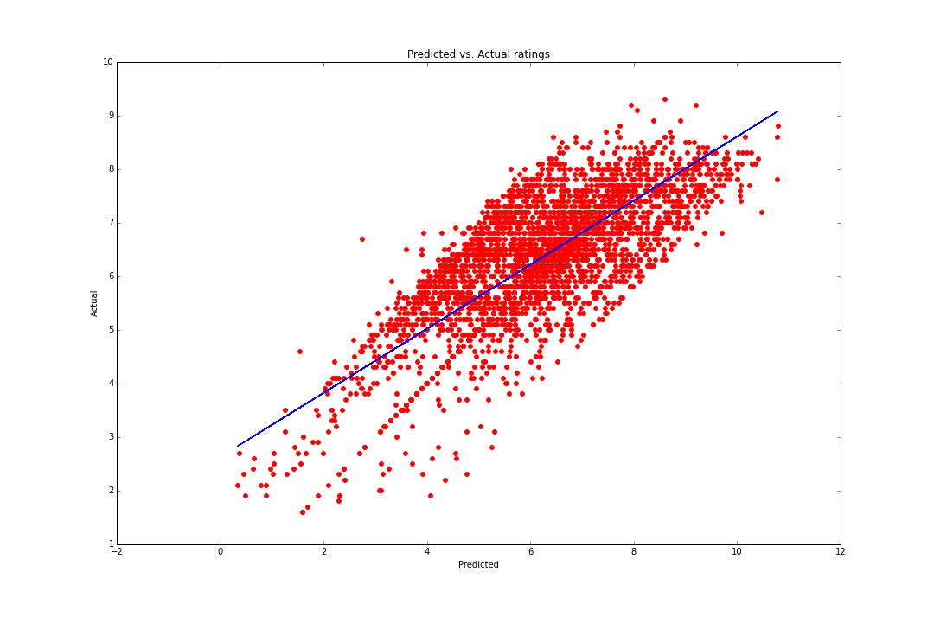
OBSERVATIONS

Slide 8
OBSERVATIONS
Scatter points closely lying around the line of best-fit (blue line), indicating a strong positive correlation between the actual ratings and the predicted ratings.
Root-mean-square error (RMSE): 0.8112

Slide 9
ISSUES
Scaling: the outcome rating with certain predictors crosses the 10 point mark
Memory management: since feature vectors are being created for categorical data, such as multiple actors, currently only considering movies above a certain threshold; this threshold is the nth percentile of the list of number of iMDB votes of all movies with non-zero votes. The training dataset includes only movies with votes above this value. Standardized approach rather than using a constant. (Movie count: ~5000, actors count: ~9000)

